Slide 2
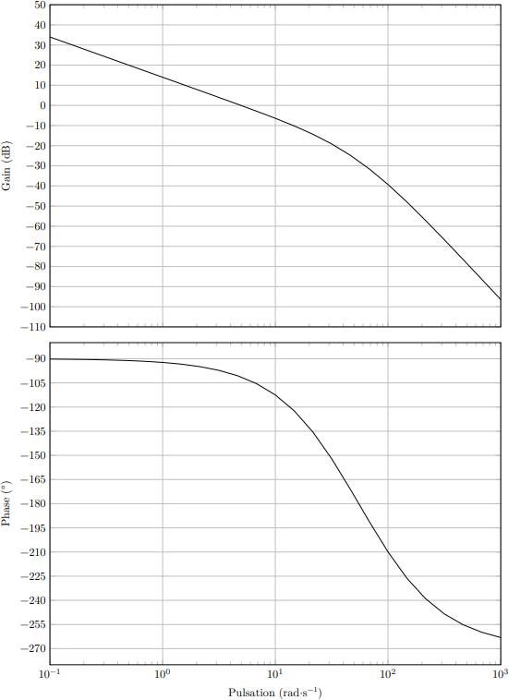


$$M_{G}=30 dB$$
$$M_{φ}=70 °$$

Slide 3
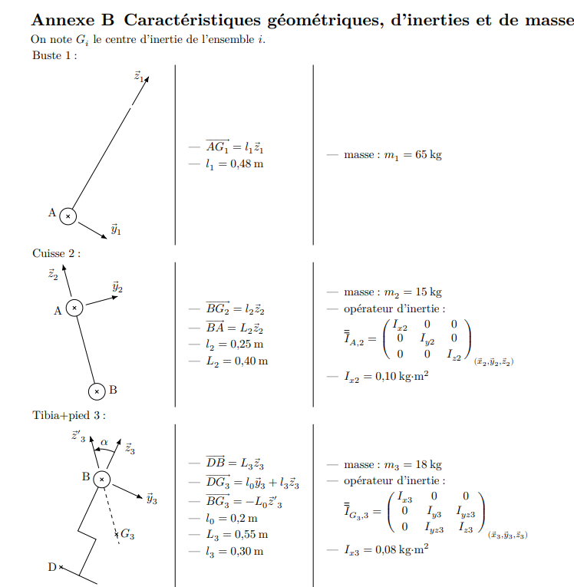
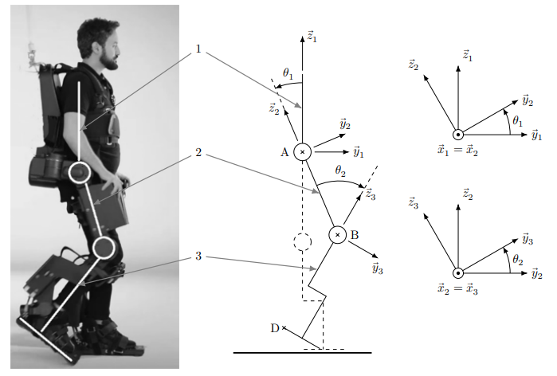


$$\vec{z_{3}}′$$
$$\vec{y_{3}}′$$

Slide 4
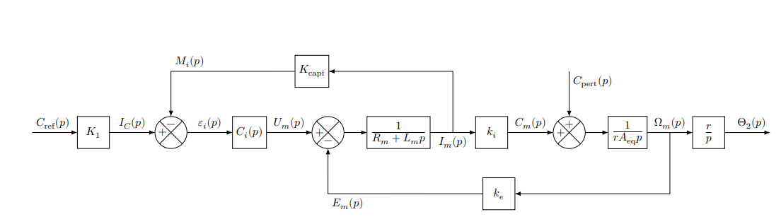








$$K_{capt}$$
$$K_{1}$$
$$C_{1}(p)$$
$$\frac{1}{R_{m}+L_{m}p}$$
$$k_{i}$$
$$\frac{1}{rA_{eq}p}$$
$$\frac{r}{p}$$
$$k_{e}$$

Slide 5


$$K_{capt}$$
$$K_{1}$$
$$C_{1}(p)$$
$$\frac{1}{R_{m}+L_{m}p}$$
$$k_{i}$$
$$\frac{1}{rA_{eq}p}$$
$$\frac{r}{p}$$
$$k_{e}/C_{1}\left(p\right)$$

Slide 6
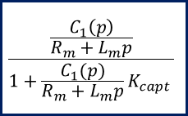
$$\frac{\frac{C_{1}\left(p\right)}{R_{m}+L_{m}p}}{1+\frac{C_{1}(p)}{R_{m}+L_{m}p}K_{capt} }$$
$$K_{capt}$$
$$K_{1}$$
$$C_{1}(p)$$
$$\frac{1}{R_{m}+L_{m}p}$$
$$k_{i}$$
$$\frac{1}{rA_{eq}p}$$
$$\frac{r}{p}$$
$$k_{e}/C_{1}\left(p\right)$$

Slide 7




$$K_{1}$$
$$\frac{C_{1}(p)}{R_{m}+L_{m}p+C_{1}(p)K_{capt} }$$
$$k_{i}$$
$$\frac{1}{rA_{eq}p}$$
$$\frac{r}{p}$$
$$k_{e}/C_{1}\left(p\right)$$

Slide 8



$$\frac{R_{m}+L_{m}p+C_{1}(p)K_{capt}}{C_{1}(p)k_{i}}$$
$$K_{1}$$
$$\frac{C_{1}(p)}{R_{m}+L_{m}p+C_{1}(p)K_{capt} }$$
$$k_{i}$$
$$\frac{1}{rA_{eq}p}$$
$$\frac{r}{p}$$
$$k_{e}/C_{1}\left(p\right)$$

Slide 9
$$\frac{R_{m}+L_{m}p+C_{1}(p)K_{capt}}{C_{1}(p)k_{i}}$$
$$K_{1}$$
$$\frac{C_{1}(p)}{R_{m}+L_{m}p+C_{1}(p)K_{capt} }$$
$$k_{i}$$
$$\frac{1}{rA_{eq}p}$$
$$\frac{r}{p}$$
$$k_{e}/C_{1}\left(p\right)$$

Slide 10
